Slide 1

Topic Modeling
INF2010 – NLP Reading Course
Rod Ali Mazloomi

Slide 2

Contents
Introduction
What is topic modeling?
Why is topic modeling useful?
Applications of topic modeling
Existing topic modeling methods
Latent Dirichlet Allocation (LDA)
Challenges in topic modeling

Slide 3

What is topic modeling?
Topic modeling is an approach to find groupings (topics) from a corpora of documents, even when we don’t know what these topics are [1]
Topic modeling is an unsupervised learning method
Each document contains multiple topics
Each topic contains multiple words
For example: Topic science may contain the words particle, planet, microscope and chloroplast
This Photo by Unknown Author is licensed under CC BY-SA
Notes:
Corpora is a set of documents
A document is a set of words
A topic is a probability distribution over the vocabulary of words in all documents

Slide 4
Why is topic modeling useful?
Unstructured text data comprises up to 80% of the data being accumulated by organizations [2]
Deriving insights from a large corpora is time-consuming or impossible to do
Using topic modeling we can derive topics to give us better insights into our corpora

Slide 5
Applications of topic modeling
Information Retrieval
Topic modeling is used to derive topics to enhance the document retrieval and search process
Social sciences
Social scientists use topic modeling to understand social phenomena through textual data [3]. For example, studying cyber-bullying through analyzing social media data.
Bioinformatics
Topic modeling used to find patterns and topics within biological structures, such as genetic information
Computer vision
Topic models are being used to assist in image classification [4]
[4] Cao, Liangliang, and Li Fei-Fei. "Spatially coherent latent topic model for concurrent segmentation and classification of objects and scenes." 2007 IEEE 11th International Conference on Computer Vision. IEEE, 2007.

Slide 6
Existing topic model methods
Latent Dirichlet Allocation (LDA)
Most popular topic modeling method
developed by Blei, Ng, and Jordan in 2003
Samples from a Dirichlet distribution
Correlated Topic Model (CTM)
proposed by Blei in conjunction with Lafferty in 2006
Samples from logistic normal distribution
Recognizes correlations between multiple topics
Pachinko Allocation Model (PAM)
Creates a directed acyclic graph to capture sub-topics and super-topic relationships
Labeled Latent Dirichlet Allocation
A supervised approach to LDA where topics are found to preset topics

Slide 7
Latent Dirichlet Allocation (lda)
A generative statistical model
LDA takes as input a (1) set of documents and (2) target number of topics k
LDA assumes that [5]:
The content of a document is composed of combining one or more documents
Certain words can belong to multiple topics
Most documents will only contain a relatively small number of topics
Within a topics certain words will be used with a greater probability (topics have a probability distribution over words)
Notes:
Generative models are considered as a class of statistical models that can generate new data instances.

Slide 8
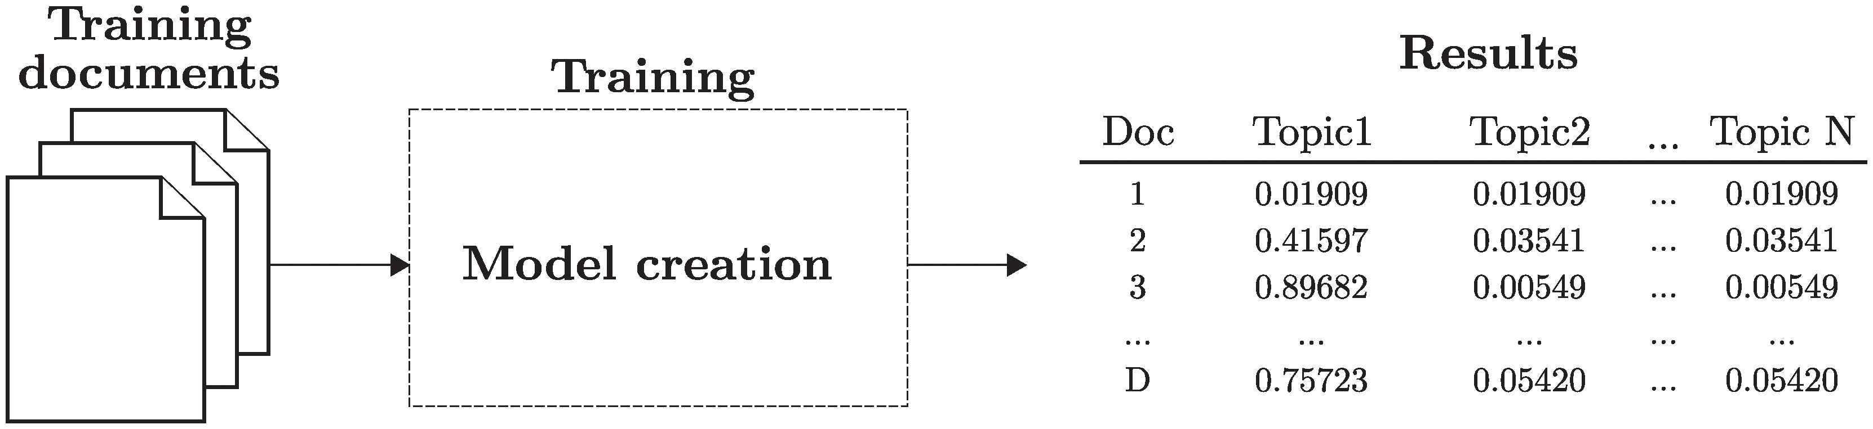
LDA contd.

Slide 9
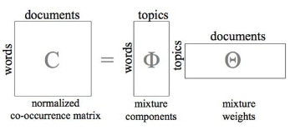
LDA Contd.

Slide 10
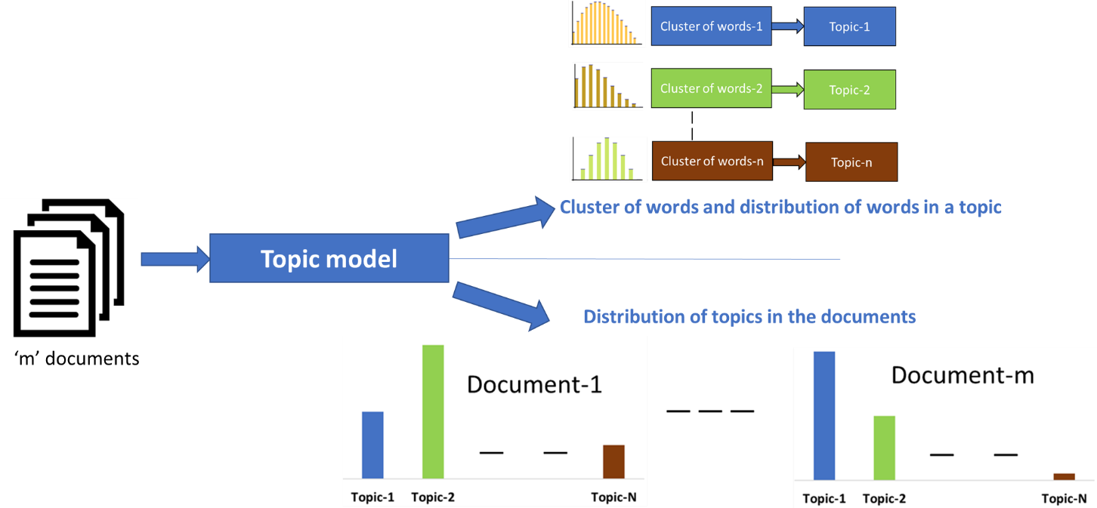
LDA CONTD.

Slide 11
Challenges in topic modeling
1. Characterizing topics is hard
Topics are defined as a probability distribution over the vocabulary over the corpus
Some top k words can be used to describe a topic, but this remains a challenge
2. Naming topics is hard
LDA outputs unlabeled topic groupings (topic 1, topic 2, topic 3, etc)
It is difficult to choose a single representative title or name for a topic
Commonly this is a post-hoc process done by a practitioner looking at the top words used in a topic

